Slide 1
PYTHON PROJECT
CAR GAME USING PYGAME
NAME:RACE RUSH - CAR CRAZE
- AFREEN SAGRI

Slide 2
CONTENTS:
1.OBJECTIVE
2.ANALYSIS
3.DESIGN & COMPONENTS
4.CODE
5.OUTPUT

Slide 3
Objectives:
The objective of this car racing game is to provide players with an engaging and exhilaeating gaming experience that simulates the trill of real life car racing . By offering graphics and mechanics , the game aims to entertain players while racing skills.
1.Drive safely
2.Score points
3.Advance levels
4.Pause and un-pause
5.Crash avoidance
6.Enjoyment

Slide 4
WHY PYGAME…?
Py-game is A popular python library used for creating 2D games and multimedia applications.
It provides a set of modules and functions that simplify game development by handling tasks like graphics, sound, input handling, and more.

Slide 5
ANALYSIS:
1.Initialization:The code initializes Py-game , sets up the game window with dimensions , defines colours and load necessary images and sounds.
2.Game loop:
‘intro_loop() – This function displays the game’s introductory screen with option to start the game ,quit or view instruction.
‘introduction() – Displays instruction on how to play the game.
‘paused()’ – pauses the game and displays options to continue , restart , or return to the main menu.
‘Un-paused()’ – resumes the game after being paused.
Countdown() – displays a countdown before starting the game.
3.Button handling : button() – Draws button on the screen and handles mouse interaction for starting the game , quitting , going to instruction ,pausing , unpausing and returning to main menu.
4.Obstacles handling : This function loads and displays different types of obstacles at random position.
5.Scoring : Updates and displays the players score and the number of the obstacles passes
6.Text and message display:
’ text_object ()’ : renders text using the specified font.
‘Message_display()’ : displays a message on the screen , often used to show the “you crashed” messages.

Slide 6
DESIGN
Initialization
Game Windows and Clock.
Image Loading and Scaling
Game State Handling
Button Handling
Obstacle Generation
Scoring and Text Rendering
Crash Handling
Background Scrolling
Main Functionality
Game Start
Game Over and Quitting
COMPONENT
Initialization :’ Pygame.Init()’
Loading Assests : ‘Pygame.Image.Load()’,’ Pygame.Transform.Scale()’
Game Window : ‘Pygame.Display.Set_mode()’,’ Pygame.Display.Set_caption()’
Game Loop :’ Game_loop()’
User Interface Element: ‘Button()’, ‘Text_object()’
Countdown: ‘Countdown()’
Collision Detection :’ Crash()’
Audio:’ Pygame.Mixer.Music’
Quitting The Game:’ Pygame.Quit()’
Main Game Flow:’ Intro_loop()’

Slide 7
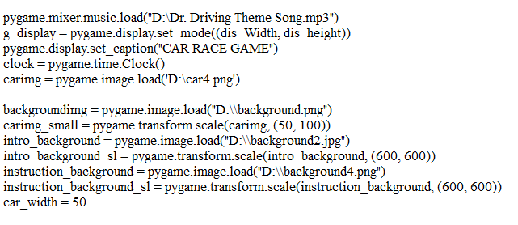
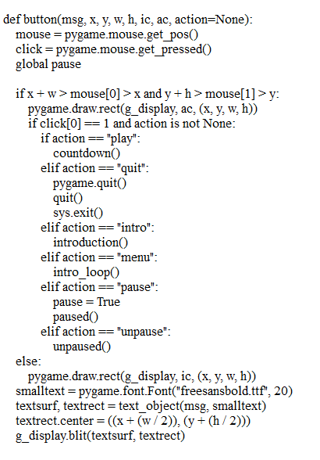
CODE:
Intro-loop:
Button-loop

Slide 8
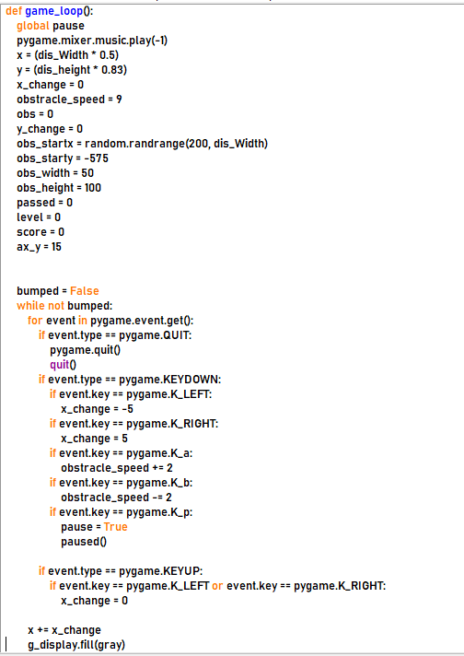
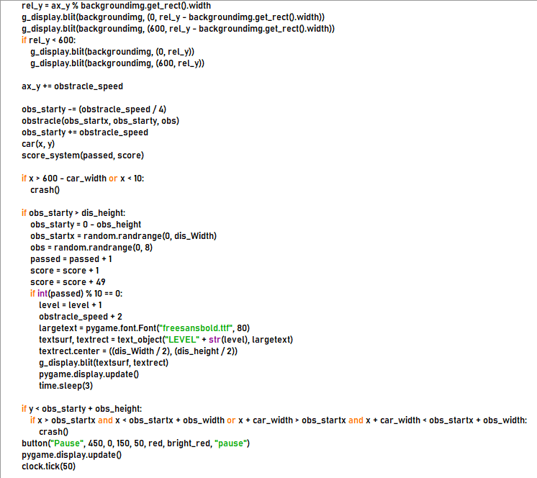
GAME-LOOP:

Slide 9
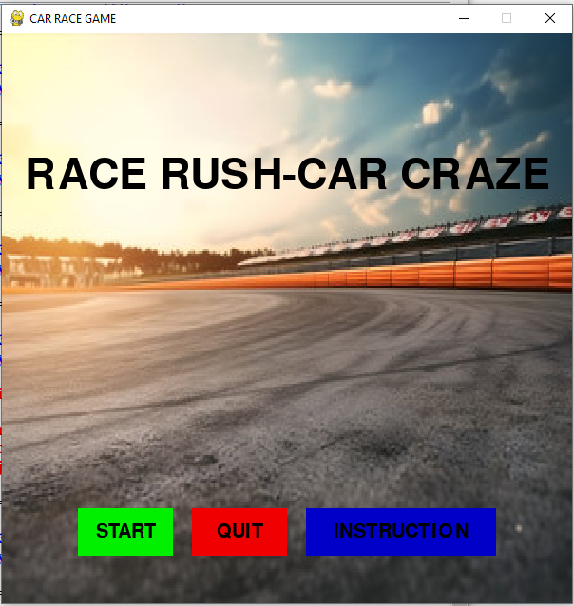
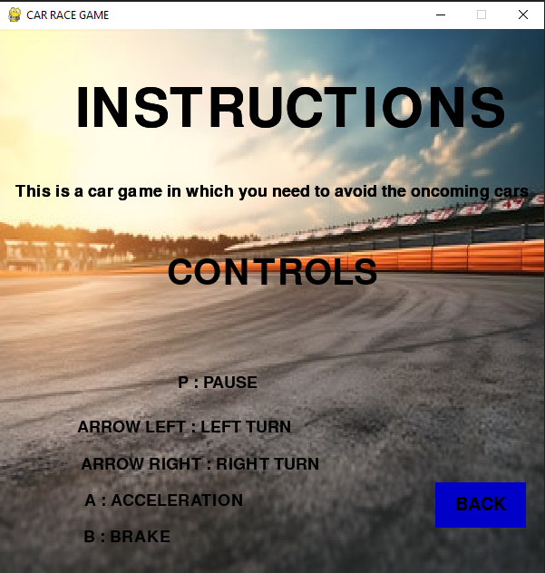
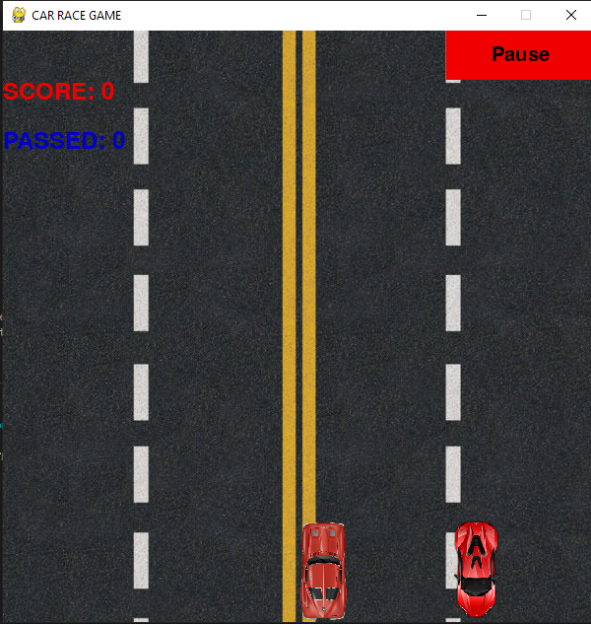
OUTPUT:
MAIN SCREEN
INSTRUCTION SCREEN
GAME START

Slide 10
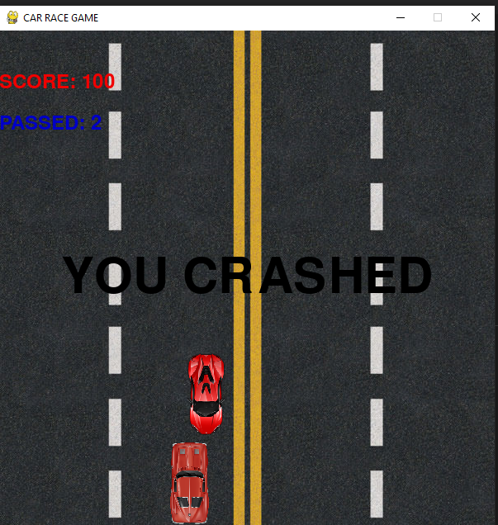
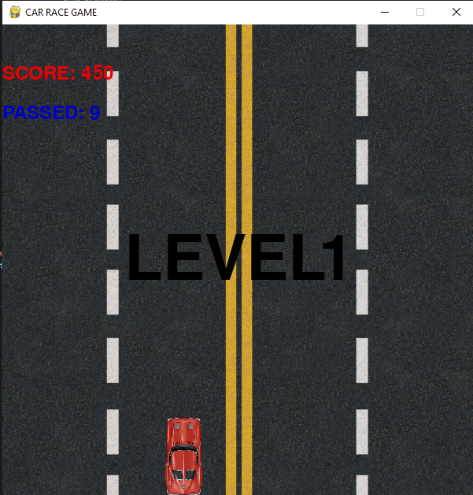
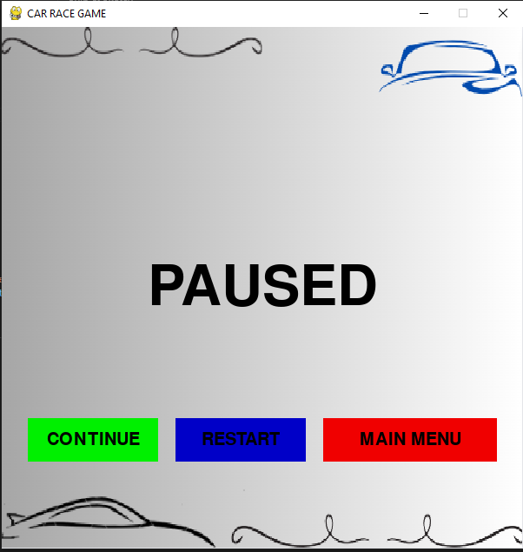
PAUSED SCREEN
CRASHED
LEVEL UP

Slide 11


